Slide 1

SPAs Without Javascript Simplify Your Stack
Create a pet
Brian Meeker
Sr. Software Engineer at GetThru
https://that-pet.fly.dev
Notes:
Good morning everybody! I hope you've been enjoying your CodeMash. Who enjoyed the return of the waterpark party last night? Me too. This is my 11th CodeMash and getting a drink at the hot tub bar is always a highlight for me.
But we're hot here to talk about hot tubs, we're here to talk about SPAs.
And this is a good time to remind you of the rule of two feet. If you're offended by terrible puns and dad jokes, or if the content of this talk just isn't working for you, vote with your feet and go make better use of your time. I won't be offended.

Slide 2

Brian Meeker
Website
https://brianmeeker.me
GitHub
@CuriousCurmudgeon
Bluesky
@brianmeeker.bsky.social
Notes:
My name is Brian Meeker. I spend my work hours as an Elixir dev at GetThru. I’ve been using Elixir for a couple of years now at my day job. Before that I was mostly a C# dev for many years. A couple of pit stops in Ruby land. Multiple tours of duty with Perl somehow. And yes, varying amounts of JS while doing just about all of those.
This picture was taken right after being back on the ground after jumping out of a plane. The joy I get using Elixir every day now is similar.
You can mostly find me these days on Bluesky. These slides will be available on GitHub. I'll have a QR code link at the end to the repo.

Slide 3
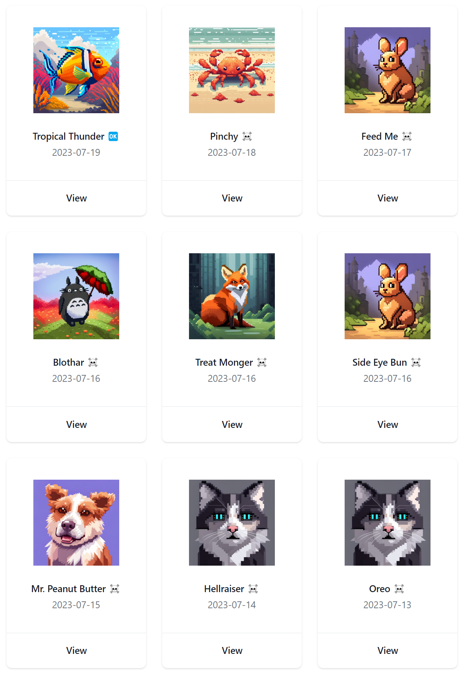
Agenda
A Brief History
Hotwire
HTMX
Phoenix LiveView Deep Dive
Notes:
With that out of the way, let's talk about what's in scope for today. We have 50 minutes, so you're not going to walk out of here as an expert in Hotwire, HTMX, or LiveView. I put together this talk and I am only an expert in one of these.
We're going to start with a very, very brief history of rich interaction frameworks on the web. Then we’re going to look at a simple app I built in Hotwire, the brand name for SPA model built into Ruby on Rails. We’ll also look at HTMX, which takes what I find to be a delightful approach to the problem.
We’re going to spend most of our time though looking at Phoenix LiveView, which is going to require a tangent into the Elixir actor model and processes. This will hopefully make it easier to understand the elegance of LiveView, which builds on top of the Elixir process model. Then, through a series of demos we’re going to build up most of the features you see in THAT Pet today, all without writing a single line of JavaScript.
So, that's a lot of things to cover in a short time. Let’s dive in

Slide 4
Goal
You Build Something
Notes:
For some of you, this is the fourth day you’ve been at CodeMash. For others, it’s only the second. Either way, chances are good that you’re tired from yesterday and talks you’ve already attended this morning. You’ve been bombarded with lots of things that you are excited about. That’s one of the great things about conferences.
My goal is simply this. I want you to leave this room today excited enough to build some project in one of options I mention. That could be right after this session. It could be this weekend. It could be next month or next year.
And, hey, if this isn’t the session that excites you the most, I hope you take the time to dive more deeply into whatever new thing strikes a chord with you this week. Don’t leave CodeMash with the intent of one day diving deeper into something. As you leave the conference, pick which one thing you want to learn more about and go for it.

Slide 5

Every Speaker Is Biased
Notes:
One last thing before we dive into these frameworks. I am biased. Every speaker you see at every conference is biased. I am of the view that you should ignore the opinion of anybody who has not used a particular stack or piece of technology in anger. This means having deployed it to production for an extended period of time with real traffic hitting it.
The only one of these that I've used in anger is Phoenix LiveView. I've been using it full time for the past couple of years. I love it, but I'm also realistic about it. It has shortcomings. We'll get to those.
But I am absolutely a shill for Elixir and LiveView. I think the Elixir process model is uniquely well suited to this problem space and that other frameworks can not match it because they do not have the BEAM, the VM Elixir runs on. They can only poorly imitate it.
You should take anything I say about Ruby on Rails with Hotwire with a huge grain of salt. I haven't written production Rails code since 2013. Let's not think about how many years ago that was and how much more white hair I have now. Some of the pain points I hit playing around with Hotwire are purely because I don't remember how various pieces of Rails magic work and went off the happy path. If you're an experienced Rails dev, you'll probably have a better time than I did.
Ditto for HTMX. I think it's a really elegant model, but I have not used it in anger in production. Seek out the opinion of those who have.
I have also never worked full-time as part of a team building a React app. I've shipped a lot of production code in Angular and some in Vue, but not React. I am a mediocre JS dev who has little interest in becoming a better one. That is time I could be using writing Elixir instead. Or learning Haskell. Or whatever shiny new thing attracts my gaze.
Stepping back even more though, for most problem spaces, the choice of tech is pretty far down the list of contributors to success or failure. I'll bet on a team using Peral that has a deep understanding of their tools, the domain, and how to efficiently communicate as team over a poorly functioning team using LiveView any day of the week. The choice of tech is secondary to those.
If you walk away from this talk excited to jump into one of these options, none of them are going to fix your team's understanding of the domain. They *could* however, improve your team communication if the tool allows you fold together separate back and front end teams into one.
This is one of our secrets to productivity at GetThru. Everybody is a full stack dev writing Elixir. There is no communication across separate teams within engineering. And that is wonderful.

Slide 6

What Is a SPA?
Notes:
What is a SPA, a single page application? Any ideas? Feel free to shout them out. Don't be shy.
To me, a SPA is defined by dynamically rewriting sections of the page instead of reloading the entire page. The ultimate goal is for the page to feel more like a native app, a single page that only updates parts as needed.
Now, in reality, there is a lot of grey area here. What if you use a framework that replaces that entire body tag and merges in changes to the head tag? That technically is dynamically rewriting the page. In Ruby on Rails, this is what Turbo Drive gives you out of the box. That meets the definition, but does it meet the spirit? Maybe?
Should it work offline? Maybe? Most frameworks don't do this.
What if you have a series of complex single page apps as part of a multi-page application? Does that count as a SPA? I don't know. I also don't particularly care, and, importantly, neither do your users.
And that is because your users care about the experience. If part of your app is very dynamic and the UX is better with a SPA-like interface, than that is what matters.

Slide 7

In The Beginning There Was
Notes:
This is technically not true. For the old timers in the audience, do any of you remember the first time you used Google Maps? That is probably the first SPA that most people used when it launched in 2005. I was in college at the time. Some Google Maps team members came to my college CS department to give a talk on the tech behind the UI. At the time it was wild. There was this new thing called AJAX.
But if anybody here has used the old XMLHttpRequest API in the browser, you probably remember that it was awful. If you haven't used it or don't remember how awful it is, go look it up on MDN and try it out. This was cutting edge at the time.
Anyways, for most folks, the real beginning was jQuery. It's hard to overstate how revolutionary jQuery was. Javascript was an atrocious backwater of browser incompatibiliites at the time. IE 6 was the bane of developer's existence. Chrome didn't exist yet. Firefox was eating into IE's market share. Getting anything work across browsers or with the limited browser APIs at the time was a non-trivial amount of work. jQuery changed that.
jQuery doesn't feel revolutionary today because so much of what it does has been brought natively into the browser. Once again though, it's hard to overstate how powerful it was. It made interactivity driven by JS feel possible to the average web dev. It papered over the inconsistencies across browsers to bring interactivity to the masses.
jQuery hasn't actually gone anywhere. It's on a huge percentage of websites. Number vary depending on the source, but I found roughly in the range of 62-75% of websites have jQuery. If you think React has saturated the market, it has nothing on jQuery.
And that makes sense. Most sites do not need a heavy SPA framework. They just need sprinkles of interactivity. That marketing site you're working on. It doesn't need to be using React.

Slide 8











In The End There Was
Notes:
And in the end there was React. This is, of course, a wild oversimplification, but today is not a history talk. If anybody else would like to give that history talk, I think it would be fascinating, but today is not the day and I am not the person to give it.
Nobody gets fired for rebuilding in React. It has become the default, safe choice. It's not a pure monoculture. There are plenty of other popular tools out there, like Vue and Angular. The tail is very long. I could have filled this entire page with logos.
But all of these tools use JS. And for the purposes of today, every time I say JavaScript, feel free to replace it with TypeScript. The point is still the same. The problem is still the same. I do NOT want to be spending my time writing JS when I don't have to.
Who here writes JS because they have to? Who doesn't do any front end work at all because they don't want to deal with JS? They would rather use their language of choice on the back end?
And, here is the real kicker, who here is writing JS on the backend because they HAVE to write it on the front end?
An accident of history led us here folks. Nobody in 1995 thought that Bendan Eich and Netscape were going to trap us into one language in the browser forever. Imagine a world where you can only write one language on the back end. One language for desktop apps. One language for mobile apps.
At this point, I'm losing the React devs, because they're sitting there thinking to themselves that they already do that. They package their desktop apps in Electron with React. They use React Native for their mobile apps. They write Next.js apps for web server backends. The back end goes into the React shaped hole.
If you love React, that's great. I'm genuinely happy that you get to use tools that match the way your brain thinks and you enjoy using on a day-to-day basis.
But the internet is filling up with think pieces from devs who are fed up with it. And I'm happy to report that there the number of JS-free or JS-lite options are increasing.

Slide 9

Do You Even Need a SPA?
Notes:
But before we get to the non-JS or JS-lite options, step back and ask yourself if you even need a SPA framework at all? How much interactivity do your users need?

Slide 10
Answer Me These Questions Three
Is your core functionality real-time?
Are rich UI interactions core to your product?
Is there lots of shared state between screens?
Notes:
You should be able to answer these basic questions
- Is your core functionality real-time, like a chat app?
- Are rich UI interactions core to your product, like Gmail?
- Is there lots of shared state between screens, like a streaming service?

Slide 11
Component Islands
The general idea of an “Islands” architecture is deceptively simple: render HTML pages on the server, and inject placeholders or slots around highly dynamic regions […] that can then be “hydrated” on the client into small self-contained widgets, reusing their server-rendered initial HTML.
- Jason Miller, Creator of Preact (https://jasonformat.com/islands-architecture/)
Notes:
Does a hybrid approach makes sense for your app? Is most of the site static with sprinkles of interactivity? Then a "component island" architecture might make the most sense for you.
I did this for a starutp I was at in 2021. Didn't even realize the pattern had a name until after I had already implemented it. We had a C# back end that would ship JSON and Vue widgets to certain pages to hydrate self-contained widgets. It worked great.
At GetThru, even though we use LiveView everywhere, there are definitely pages that could be simple CRUD pages. We don't actually need LiveView for many pages in our app. We use it everywhere for consistency, but it's not strictly necessary from a UX perspective. We could have a multi page app with certain pages getting the SPA treatment.

Slide 12
Frameworks
Hotwire (Ruby)
HTMX (Bring your own back end)
Phoenix LiveView (Elixir)
Blazor (C#)
LiveWire (PHP)
Notes:
The rest of this talk is going to go over three of them.
- Hotwire (Ruby on Rails)
- HTMX (Bring your own back end)
- Phoenix LiveView (Elixir)
There are some other big ones out there that I'm not going to go over for time reasons.
- Blazor (C#)
- LiveWire (PHP)
I have no experience with LiveWire or PHP, but it seems beloved by those who use it. If you work in PHP, check it out.
I worked in the C# world for many years. I've played around with Blazor and it seems neat. In true MS fashion, they've muddied the waters a bit by giving two different technologies the same name.
Blazor Server is the equivalent of Hotwire, LiveView, or LiveWire. It runs .NET code on the server and then a bit of JS on the frontend provided by the framework stitches that into your front end to provide a seamless experience where you don't have to care about JS the vast majority of the time.
Blazor Client is running WASM in the browser. It compiles a subset of the .NET framework required by your app and sends it to the browser. This lets you write C# code that gets compiled to WASM and runs on the front end. That's wild, but we don't have time to go into it in detail today. Just be aware that it exists.
Importantly, all of these options also give you hooks and escape hatches to write JS when it makes sense. Depending on your app, that may be never. I've written very interactive pages in Phoenix LiveView with zero JS. But depending on what browser functionality you're using and what user interactions you want to support, you may need to write JS. And that's fine. Despite the title of this talk, the goal is not to write any JS.

Slide 13
Context switching is not
JavaScript is fine
Notes:
I don’t mind modern JavaScript on the front end. I think it’s a reasonable language now. For years it was the only option on the front end.
But context switching is not. And eliminating context switching between languages was one of the big reasons we started using JavaScript on the back end to begin with. But, in my opinion, there are much better languages to be using on the back end. And now there are tools that help eliminate the context switching by letting you write your back end language of choice for complex web apps.

Slide 14
Write Only Necessary JS
Notes:
The goal is to only write the necessary JS. The goal is to context switch between languages as little as possible and maximize staying in your ecosystem of choice.

Slide 15


HTML Over The Wire
Notes:
With all those caveats out of the way, let's talk about Hotwire.
First, Hotwire stands for "HTML Over The Wire". It's a series of libraries included with Ruby on Rails to allow you to create rich user interactions by sending HTML over the wire instead of JSON. The JS portion of the library takes that HTML and inserts into the page in the correct locations. At it's core, that is it.
You're not going to find any library actually called "Hotwire" in Rails. Instead, Hotwire is simply branding on top of a series of libraries with the "Turbo" prefix.
Technically, these libraries can be used with other frameworks, not just Rails. I didn’t find much evidence of that happening beyond toy projects though. If anybody knows of any, please let me know now or after.

Slide 16
Wasn’t Turbo Already a Thing?
Notes:
The name "Turbo" has long history in Rails. It was first used in Rails 3.2 way back in 2012 for Turbolinks and it became the default in Rails 4 in 2013.
Turbolinks worked by intercepting link clicks and form submissions. It makes an AJAX request to the server and gets back the new page's HTML. It swaps out the current page's body and title tags with those from the new page. Then it uses the `pushState` API to update the URL.
Technically, you could argue that using Turbolinks for every single link on your site makes it a SPA. The full page never refreshes. However, it's not exactly efficient. Even if almost the entire page is exactly the same, your backend is still re-rendering the entire thing, passing all the HTML back over the wire, and then replacing the entire body. If 99% of the page is the same, you're still replacing the entire page.
Still, this was a great start. Turbolinks 5 iterated on this in Rails 5 in 2016.

Slide 17

Notes:
When searching for documentation related to Hotwire, you're likely to also stumble across a project called StimulusReflex. This is an external project that builds on top of Rails and Stimulus to provide real-time capabilities over websockets. Stimulus is a library in Rails to to add JS functionality to pages.
It was inspired by Phoenix LiveView to provide similar functionality to Rails. You'll find this is a pattern in most communities. People got excited about Phoenix LiveView when it was first announced in 2018 and tried to port it to their community with varying degrees of success.
StimulusReflex blazed a path in the Rails community that has largely been taken over as more and more of that functionality is added to core Rails. With Rails 8, there is discussion about how much more development should even happen in StimulusReflex. Feel free to look at it, but we're going to focus on Rails 8 and Hotwire today.

Slide 18
Turbo Drive
Notes:
The first part of Hotwire is Turbo Drive. You can think of Turbo Drive as a replacement for Turbolinks. It's enabled by default in Rails 8. Just like Turbolinks, it watches for link clicks and form submissions. The JS library will intercept those requests and make an AJAX request to the server instead. It will take the result and replace the current body tag with the new body tag. It will then merge together the head tags and update the URL as needed.
This is exactly as naïve as it sounds. Doesn’t matter if most of the new page is the same, we’re just replacing the entire body tag. You can configure Turbo Drive to use morphing with the idiomorph library. What this means, is that when Turbo handles a page refresh, it will only update the DOM elements that changed. That’s certainly an improvement. I’m not sure why this isn’t the default. Perhaps some sort of backwards compatibility reason?

Slide 19
Turbo Frames
Notes:
Turbo Frames are a more targeted version of Turbo Drive. It lets you update only predefined portions of the page. You define a <turbo-frame> tag with a unique ID. Any links or forms inside of a `turbo-frame` tag will be captured by Turbo Frames. The server response must contain a `turbo-frame` tag with a matching id. The contents of that `turbo-frame` tag will replace the old contents.
If your response contains an entire HTML page, everything outside of the `turbo-frame` tag will be discarded. Only the contents of the `turbo-frame` will be used. If your HTML only contains the `turbo-frame` fragment and its contents, then nothing needs to be thrown away. It's up to you to decide how to do this. If you're retrofitting Turbo Frames into an existing codebase, then it probably makes sense to start simple and render the entire page and let Turbo Frames throw everything else away. You can optimize later.
If you're starting with a greenfield, then it might make sense to treat these kinds of requests as events that return fragments. The choice is yours. Rails magic will push you in certain directions as well. Rails really wants you to do things in a certain way. I did not attempt to go off the Rails happy path here, but you would need to render without a layout and only return a small fragment. Probably worth it at scale as you optimize. When getting started though? Probably not worth it yet.
Turbo Frames offers a lot of power. You can have it lazy load frames only when content would become visible. You can break out of the turbo frame to update the entire page's content when needed. There is built in anti-forgery support with CSRF. Neat stuff.
I think the neatest stuff though is with Turbo Streams.

Slide 20
Turbo Streams
Notes:
Turbo Streams were the first part of Hotwire that piqued my interest. Turbo Drive and Frames are fine, but those are basic table stakes for simple interactivity. Turbo Streams is where the cool stuff comes in.
Similar to Turbo Frames, Streams delivers pages changes as fragments of HTML wrapped in a `<turbo-stream>` element. Each stream element has an action and a target.
The target is a CSS selector. It could be just a single target selected by ID or multiple targets with a CSS selector. The actions are one of
- Append
- Prepend
- Replace
- Update
- Remove
- Before
- After
- Refresh
I was a bit confused at first the difference between replace and update. Replace replaces the target tag with the stream content. Update only updates the contents of the target tag with the stream content.
The only other slightly odd one is Refresh. That will trigger a full page refresh. The rest do exactly what you would think.
The cool thing about streams is that they can be delivered to the browser synchronously as an HTTP response, or, more interestingly, async over a websocket or Server Sent Events. I haven't used Server Sent Events, but I have used websockets a lot with Phoenix Live View.
The thing that excites me about this is that websockets really unlock the real-time web. And using them with Turbo Streams gives you real-time updates without writing any JS yourself. The power is right there.

Slide 21

Demo
Notes:
Let's try it out a bit.

Slide 22

Notes:
Next, let's talk about a framework that take a very different approach, HTMX.
Who here has heard of HTMX? It got a lot of buzz over the past couple of years. Who has used it in prod?
HTMX has the goal to "complete HTML as a hypertext". Hypertext itself is a deep rabbit hole deeply embedded with the origins of the World Wide Web. We're not going down that rabbit hole today. For our purposes today, HTMX adds attributes to HTML to trigger AJAX requests to dynamically update the DOM.
This drastically reduces or even eliminates the need for HTML in many use cases. Similar to Hotwire, we are delivering HTML over the wire. The backend is responsible for all logic and just gives back fragments of HTML. The front end doesn't need to parse any JSON, do any client side routing, or manage complex state. It just makes AJAX requests and sticks new HTML into the DOM.

Slide 23

Demo
Notes:
So, I started going down the rabbit hole of writing my own demo app for HTMX, only to realize that the HTMX docs have absolutely fantastic examples. Let's walk through some of those to get a feel for how this works. That is not something I could say for Hotwire, where the docs feel very fragmented. That’s pretty disappointing considering how high quality the Rails Guides have been over the years.
For all of these examples, HTMX does not care what kind of back end you are talking to. As long as it returns HTML fragments in response to HTTP requests, HTMX does not care. There are some libraries out there to make this easier in some ecosystems, but, honestly, this is a case where the problem is very straightforward and not worth taking on a dependency. Just roll it yourself in whatever framework you prefer. It mostly involves just stripping out layouts in most cases.

Slide 24

Notes:
And now the shilling can start. I love Elixir. I don’t’ expect you to walk out of here and start using it at your day job, but I do hope to impress upon you why frameworks like Hotwire end up creating poor imitations of LiveView.
Phoenix is the dominant web framework in the Elixir ecosystem. The non-LiveView portion, called ”dead views” by most in the community, roughly follows the MVC pattern. If you have experience with any other server-side MVC framework, the core principles will look pretty familiar to you. LiveView is radically different though. It’s not MVC at all.
Does anybody here complete the Stack Overflow Community Survey every year? Who looks at the results? For the past two years, Phoenix has been the most desired web framework out there and I believe it’s because of LiveView. The traditional MVC stack is fine. It works really well, but LiveView is the real breakthrough.
And that was before it even went 1.0, which officially happened last month. The Elixir community has been using pre-1.0 LiveView for years in anger, so 1.0 is partly a marketing signal and partly a sign of API maturity. It’s still exciting though.
To really understand what makes LiveView special though, we first have to go on a bit of a tangent about how Elixir works under the hood. Elixir is a functional, immutable language. And that immutability unlocks an amazing concurrency model.

Slide 25

The Elixir programming language wraps functional programming with immutable state and an actor-based approach to concurrency in a tidy, modern syntax. And it runs on the industrial strength, high performance, distributed Erlang VM
- Dave Thomas - Programming Elixir
Notes:
For historical context, Elixir runs on the same virtual machine as Erlang, commonly referred to as BEAM or “the BEAM”.
Erlang came out of Ericsson in the 1980's to control telephone switching systems. It was designed to be
Distributed
Fault-tolerant
Soft real-time (any hardware folks in the room should be nodding along that I called out "soft" real time, not hard)
Highly available
Hot swappable. You can deploy new code without taking down the system.
Erlang had been chugging along for decades before José Valim started working on Elixir in 2012 as an alternative language to run on the BEAM.

Slide 26
The Actor Model
In the Erlang VM, all code runs in tiny concurrent processes, each with its own state. Processes talk to each other via messages. And since all communication happens by message-passing, exchanging messages between different machines on the same network is handled transparently by the VM, making it a perfect environment for building distributed software.
- José Valim - Programming Elixir foreword
Notes:
Anybody know what kind of programming model this represents? Lots of tiny concurrent processes, each with their own state, passing messages back and forth with each other?
It's the actor model.
And the BEAM, the virtual machine for Elixir, implements the actor model. Let’s look at what that means in practice. As we go through code, don’t get bogged down in syntax. Elixir can look a bit strange. In some ways it masquerades as Ruby, but it is very, very different than Ruby under the hood.

Slide 27
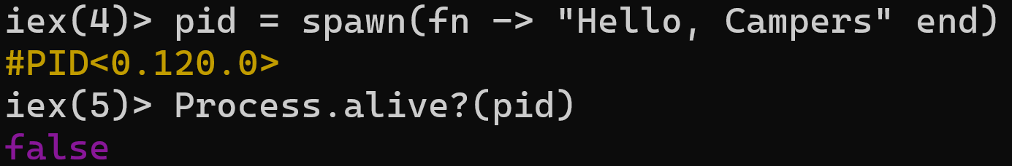

Spawning Processes
Notes:
At a very low level, you start a new process with `spawn`. It takes a function that it will execute in another process. It returns a process identifier, abbreviated as PID. The process immediately starts executing. And we can see that it is no longer alive when we check right after spawning it.
The state of each process is completely isolated. The process we spawned cannot modify any state in its parent and vice-versa. They can execute concurrently without any worries about trampling each other’s state.

Slide 28
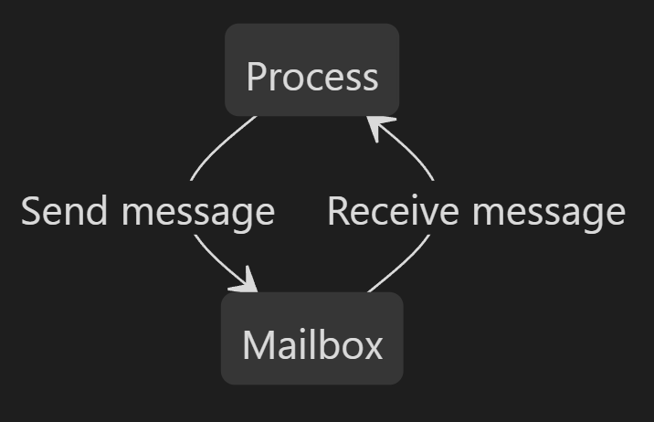
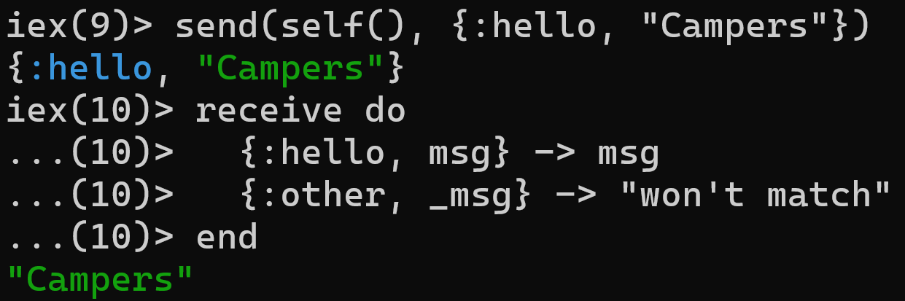
Messages
Send to myself
Pattern matching!
Notes:
We can send messages to a process with `send` and receive them with `receive`. Every process has a mailbox that stores messages it receives. `receive` blocks while waiting for a message to be in the mailbox. You can see that choosing how to handle a message is just another usage of pattern matching. We pattern match on the message itself to choose what to do.
The message just sits in the process’s mailbox until receive is called. self() gets the PID of the current process. That means that this process is sending a message to itself. This is a pretty common pattern.

Slide 29
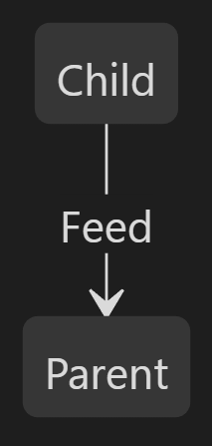
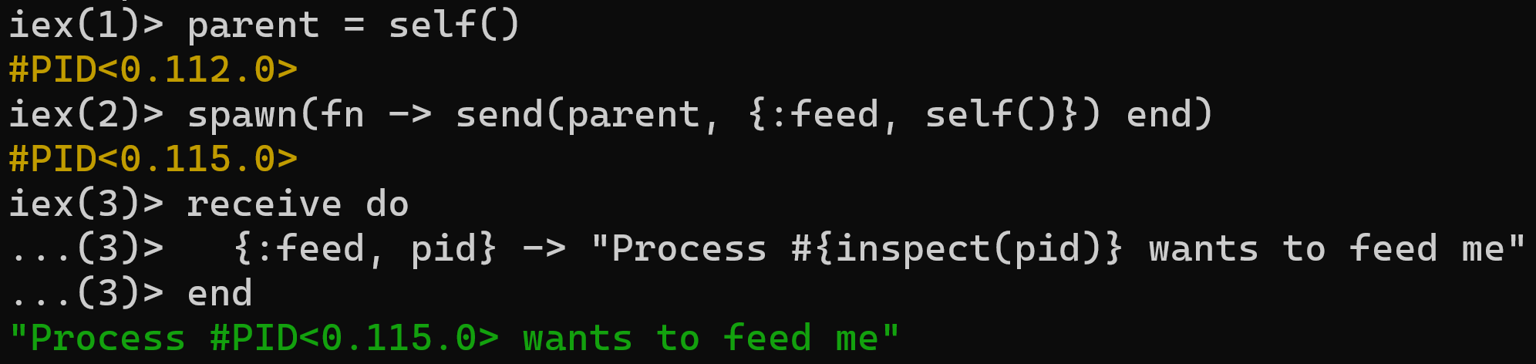
Inter-process Communication
Child process sends
message to parent
Notes:
Inter-process communication is similar. Once again, we spawn a process, but this time the new process is going to send a feed message back to its parent. The parent will receive that message and return the string.

Slide 30
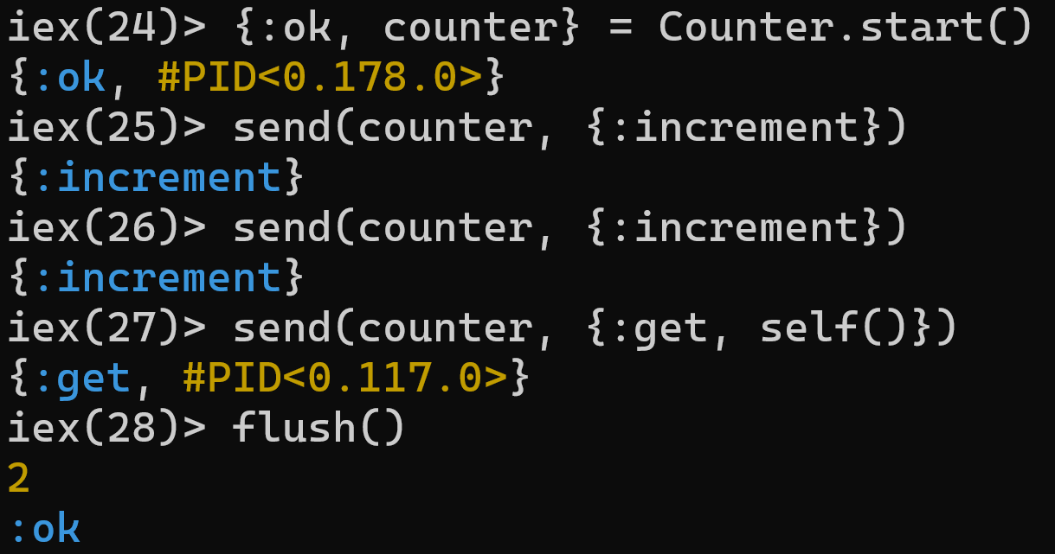
Managing State: Counter
defmodule Counter do
def start do
Task.start(fn -> loop(0) end)
end
defp loop(count) do
receive do
{:increment} ->
loop(count + 1)
{:get, caller} ->
send(caller, count)
loop(count)
end
end
end
Receive another
Notes:
Elixir is functional. There are no objects to manage state for us, but we still need to manage it somehow. This is one of the big use cases for processes.
On the left is a module that defines a simple counter. When we start it, we start a loop that just processes messages. An increment message updates the counter and a get message returns the value to the caller.
On the right, you can see an example of starting a Counter process and sending it some messages. The flush() function at the end just flushes all messages out of the current processes mailbox. We called increment twice and then get, so 2 gets flushed out of the mailbox and then an :ok saying that the flush succeeded

Slide 31
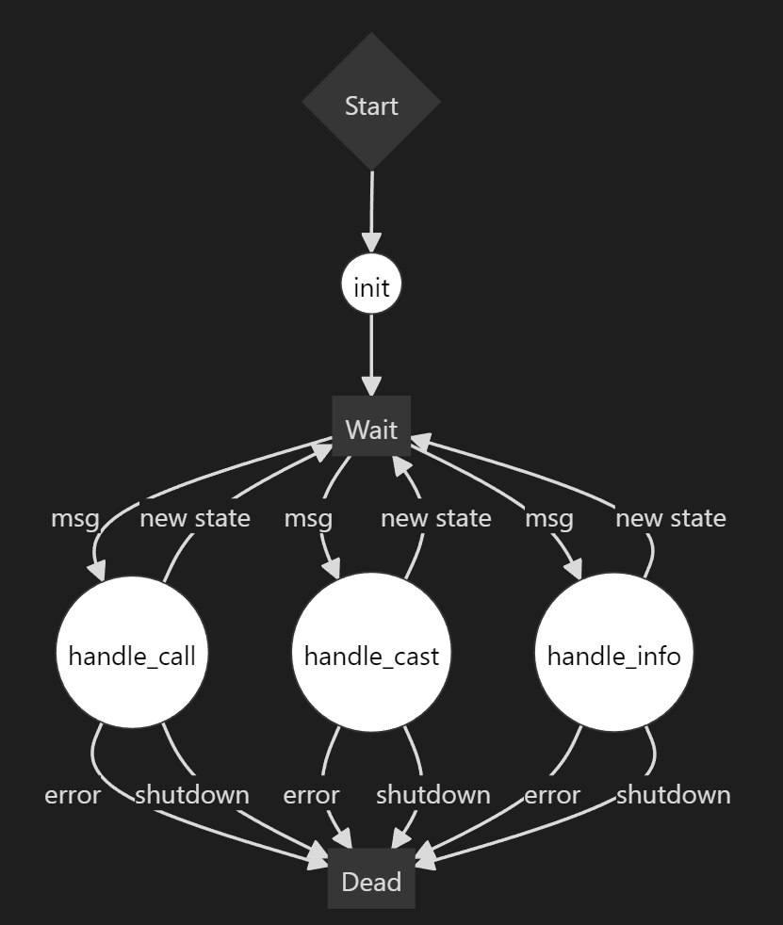
GenServer
Notes:
Now you've seen how to spawn new processes, send messages, and process them at a very low level. But in Elixir, you don't actually build applications at this low level. Instead, we use GenServers.
GenServer stands for *Generic Server* and it provides a standard set of functionality for processes. You just implement some callbacks. The most common ones are in this diagram: init, handle_call, handle_cast, and handle_info.
You start the GenServer, the init callback gets called, and then it starts waiting for messages
handle_call is synchronous. It blocks on the caller and returns a value.
handle_cast is fire and forget. It returns nothing to the caller.
We’ll talk about handle_info later.

Slide 32
GenServer: Counter
defmodule Counter do
use GenServer
# Client
def start_link() do
GenServer.start_link(__MODULE__, 0)
end
def increment(pid) do
GenServer.cast(pid, :increment)
end
def get(pid) do
GenServer.call(pid, :get)
end
# Server (callbacks)
@impl true
def init(count) do
{:ok, count}
end
@impl true
def handle_cast(:increment, count) do
{:noreply, count + 1}
end
@impl true
def handle_call(:get, _from, count) do
{:reply, count, count}
end
end
New state
Return value
Notes:
Here is the same counter example, but written as a GenServer. On the left is the client-side interface of the module. This is what consumers will actually call. It’s the same increment and decrement that we had before.
On the right are the GenServer callbacks. Both handle_cast and handle_call set a new state, but only handle_call returns a value to the caller.

Slide 33
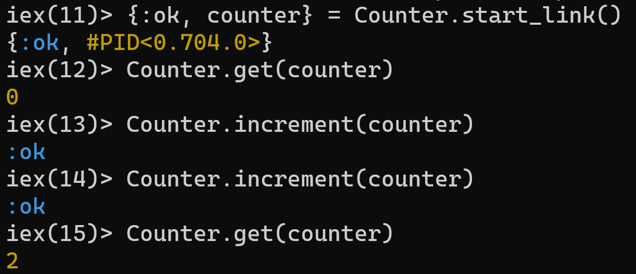
GenServer Usage
Notes:
And this is how you call it. Notice how the fact that this is a separate process is completely abstracted away from the caller. In Elixir, you’re going to be using GenServers all the time when you use various libraries and frameworks. That is almost always completely abstracted away from you though.

Slide 34
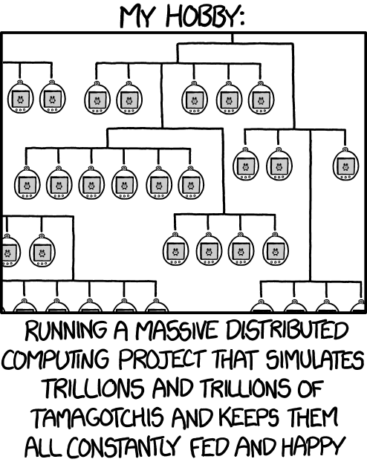
https://xkcd.com/1546/
Notes:
Who has seen this XKCD?
The idea of building some sort of fun simulation project has been percolating in the back of my head for years. And I think Elixir and LiveView are a wonderful vehicle for exactly this problem of virtual pets

Slide 35
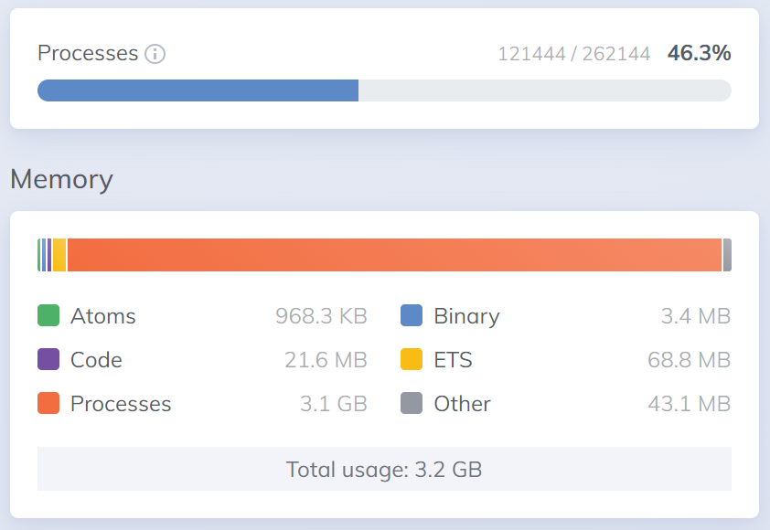
Scalability
Notes:
BEAM processes are not operating system processes. The overhead of creating a new process is a few KB. This is considerably more lightweight than threads *and* we get the benefits of isolation. You can run hundreds of thousands of these without issue in a production environment.
Out of curiosity, I wanted to see how many pets I could simulate simultaneously. I stopped at 120,000. You can see that this used 3.2GB of memory. My CPU was pegged ~30% on a pretty beefy machine.
And these processes can be distributed. We're not going to go over any of that today, but you can orchestrate across an entire cluster of nodes. The BEAM handles the details of all the communication for you. You don't have to care what node a particular process is running on at all.

Slide 36

Supervision Trees
Socotra Dragon Tree
Notes:
Every Elixir application is a tree of processes. A supervisor is a process that manages other processes.
Elixir has a philosophy of "let it crash". When a process enters an unexpected state, rather than try to recover, just let it crash. The supervisor is responsible for starting it again.

Slide 37
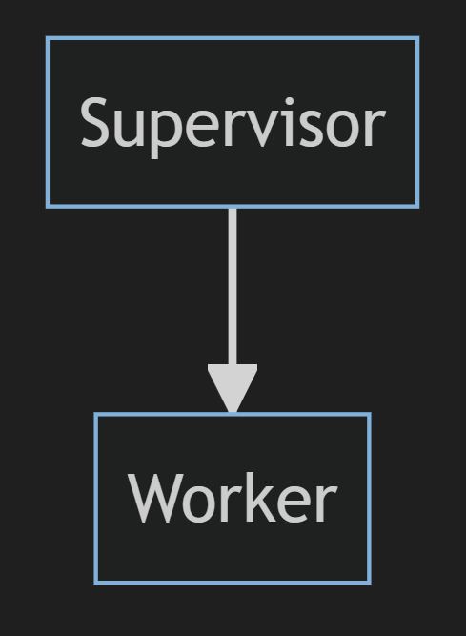
Supervising One Worker
Notes:
You can have a supervisor supervising just one worker. If that worker crashes, the supervisor will restart it.

Slide 38
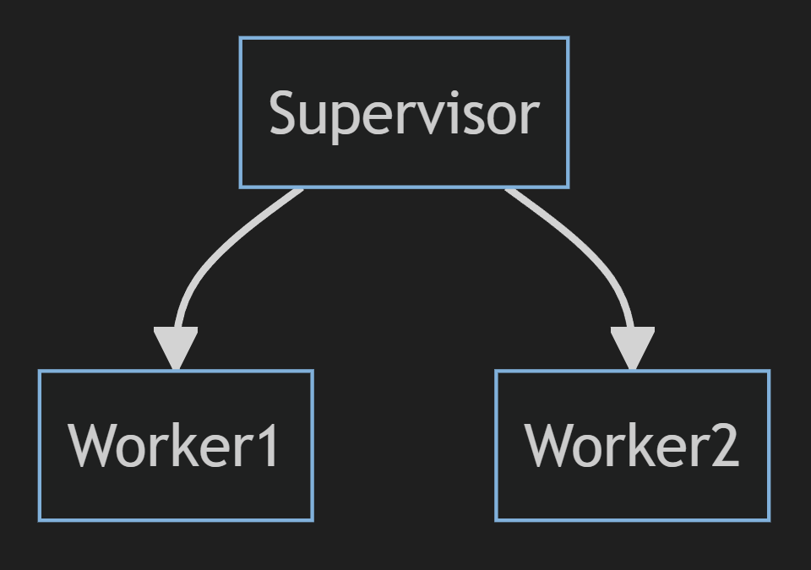
Supervising Multiple Workers
Notes:
Or your supervisor could supervise multiple workers. This is the case in LivePet, where there is a single supervisor for every pet simulation process.

Slide 39
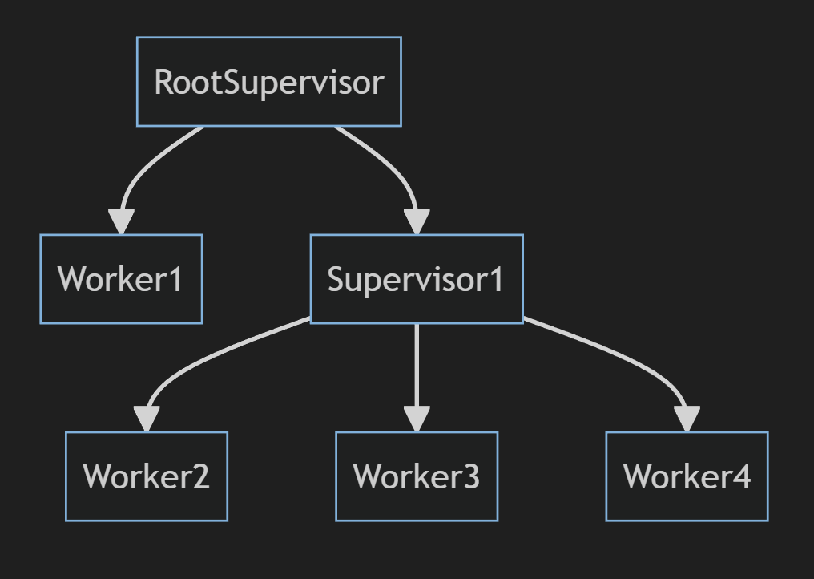
Supervision Tree
Notes:
And since supervisors themselves are just processes, applications end up structured as supervision trees. Supervisors of supersivors with worker processes of some sort as the leaf nodes.

Slide 40
Agenda
Elixir Crash Course
Processes & Concurrency
LiveViews
Events
Real-Time Updates
Components
Presence
PubSub
Notes:
That wraps up our whirlwind tour of Elixir the language and the process model. The process model is the foundation for how any Elixir app works, including a LiveView app.
Let’s move onto LiveView itself.

Slide 41
LiveView
“A LiveView is a process that receives events, updates its state, and renders updates to a page as diffs.”
- Phoenix.LiveView Documentation
Notes:
When you go to a LiveView page, a process is started receives events, updates its state, and renders updates to a page as diffs. I really want to stress that a LiveView is just another process. The tangent we just on is because the key to really grokking what LiveView is doing and how it can scale requires understanding the Elixir process model. You can certainly use LiveView if you don’t understand it, but a deeper understanding of the model it’s build on top of helps unlock it’s true power.

Slide 42
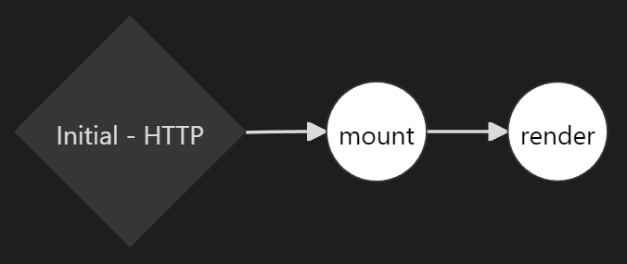
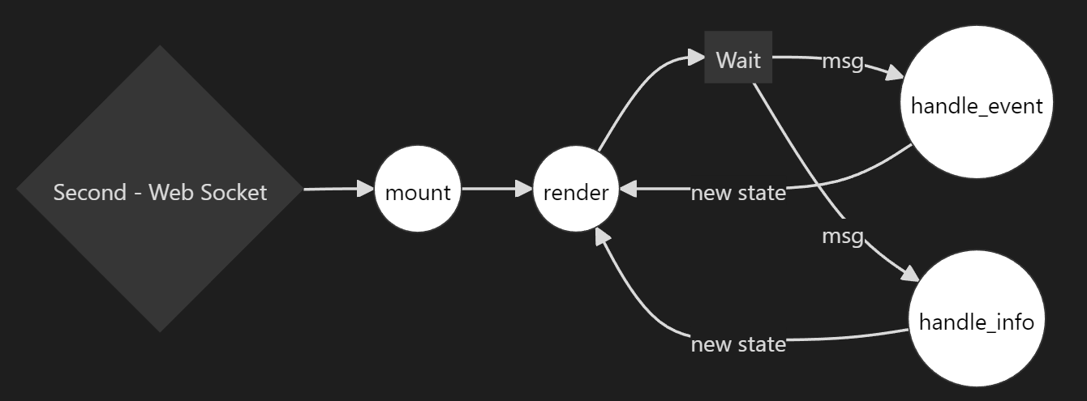
LiveView Lifecycle
Initial GET request
From client over web socket
From other process
Web Socket
Notes:
This is the live view lifecycle. The initial GET request calls a function called mount to get the state to render, then the template is rendered, and the response returned to the client.
After the client renders the response in the browser, it opens a web socket connection back to the server. Mount and render get called again. A diff gets sent back to the client over the web socket with any changes to the HTML. From there, it’s just a process. It consumes handle_event messages from the client that get delivered over the web socket, makes state changes, and renders a new state to send the HTML diff back to be applied.
And since it’s just a process, it can consume messages from other sources too with handle_info. That could be something running in your system, like a simulated pet. Or it could be a 3rd party API. Or an IoT device. If you can send a message to the live view process, you can update the state and render changes for the user from any source. The LiveView is just another process. It’s not special. You can communicate with it just like you would any other process.

Slide 43
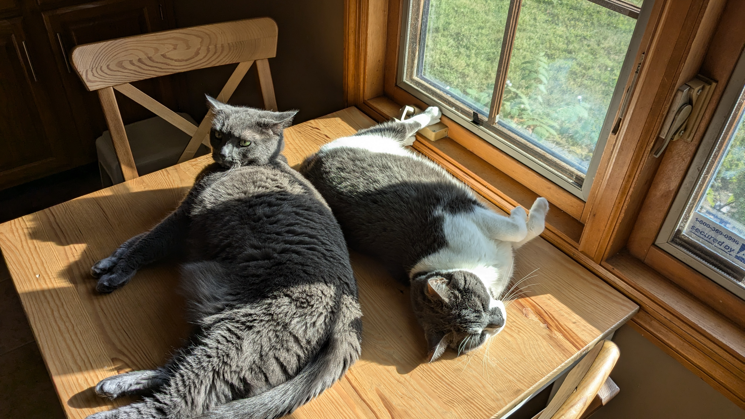
Demos
Notes:
With that, let’s start diving into some code for Live Pet. Let’s see how LiveView works and what it can do.

Slide 44
Agenda
Elixir Crash Course
Processes & Concurrency
LiveViews
Events
Real-Time Updates
Components
Presence
PubSub
Notes:
We just went over a lot. We looked at several different live views for creating a pet, listing pets, and viewing pets. We saw how we could handle events from the browser. We saw how we can get real-time updates by handling messages from the pet simulation. We saw both function and live components. And we wrapped up by looking a little bit of presence and pub-sub.

Slide 45

Website
https://brianmeeker.me
GitHub
https://github.com/CuriousCurmudgeon/live_pet
Bluesky
@brianmeeker.bsky.social
https://github.com/CuriousCurmudgeon/spas_without_js_talk
Notes:
I love Elixir. It’s my favorite programming language right now. I spent the previous decade almost exclusively as a C# dev. Switching to Elixir has been fantastic. It’s reinvigorated my love for programming. Every time I write a GenServer, it feels like I have a new super power.
I’ve added all of these resources, including the link to the GitHub repo, to the session page on the website. I’ll add the slides to GitHub shortly after the talk as well.
LiveView itself is very close to a 1.0 release. They’ve been very cautious with calling it 1.0, but they’re close to doing so. It’s very full featured already and we use it production at Online Rewards without issue.

